Slide 1


STID3074 IT Project Management Second Semester Session 2017/2018 (A172) Presentation Group Assignment 2 Prepared for: Dr. Zahurin Bt Mat Aji @ Alon STID3074 IT Project Management Second Semester Session 2017/2018 (A172) Group Assignment 1 Prepared for: Dr. Zahurin Bt Mat Aji @ Alon
Name | Matric Number
Yow Wei Lin | 245669
Nur Aini Bt Arasad | 245804
Nurizan Bt Razak | 246169
Siti Nor Fatin Bt Ahmad | 246015

Slide 2

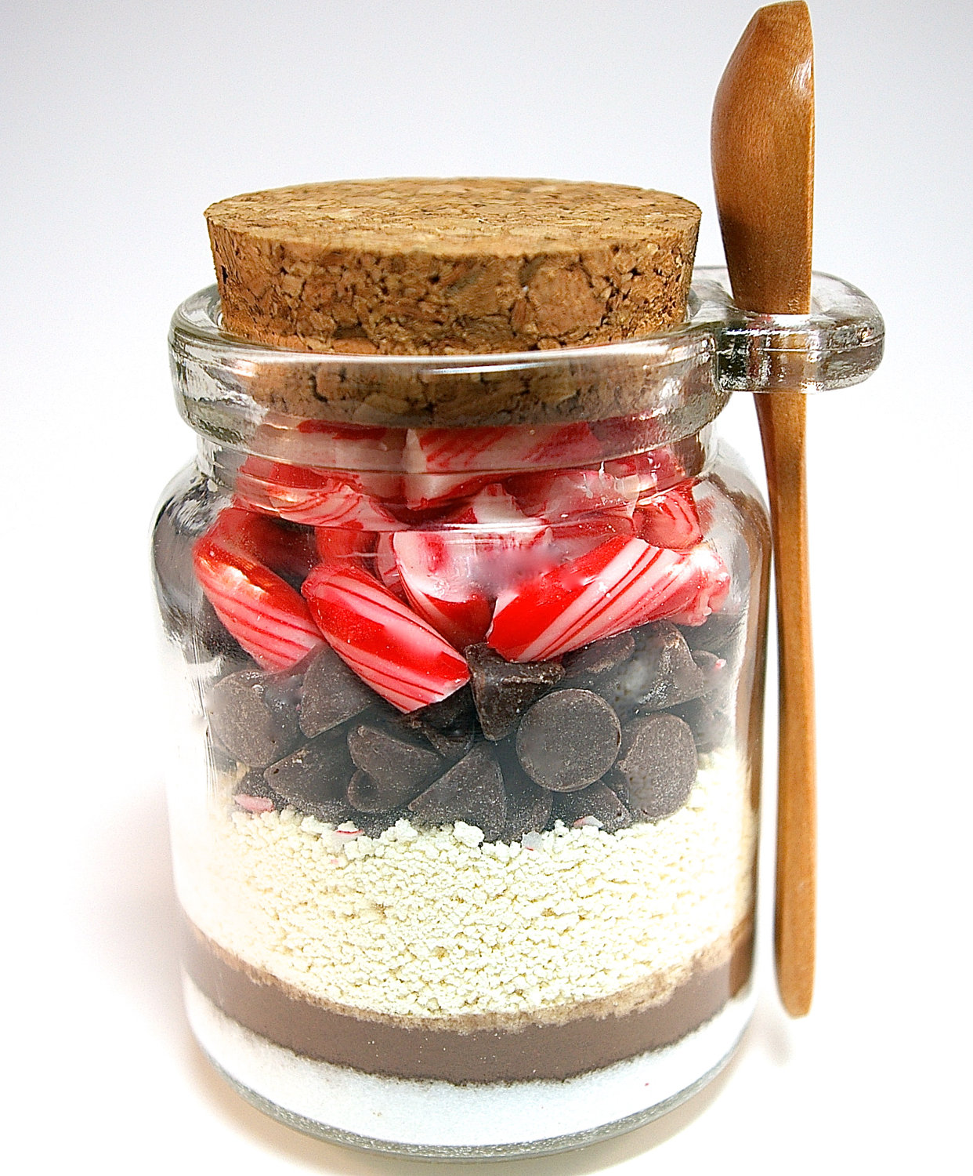
1.0 Introduction
Happy Choc Enterprise established on October 21, 2017. ​
Main business activity is the sale of chocolate snacks.​
All partners of Happy Choc have participated in the Business Student Camp Program organized by the Business Management and Student Business Division, University Utara Malaysia (UUM) to increase entrepreneurial potential and entrepreneurial skills in starting a business in UUM.​

Slide 3
2.0 Objectives
To give our customers the best quality customized chocolate
To gain the highest market share in the industry
To gain consumer confidence and loyalty

Slide 4
3.0 Current Situation and Problem
1. Technology​
The capital investment nowadays in technology had been obstructed because a competitor may wait for the next-generation technology.
Waiting to be that competitor can be equally risky. ​
The advancement technology is in conflict with the need to master a company's current technology.​
we need to gain more knowledge in handling machine as it was the main purpose our business when mostly are new companies.

Slide 5
2. Supply chains
Due to the uncertainty of demand, companies are carrying smaller inventories than ever.
Uncertainty in supply, driven by wildly changing commodity prices, increasing competition for raw materials caused the supply chain planning more challenging than ever.
Chocolate manufacturers used market research and other marketing techniques to meet customers' demands for an increasing variety of products.

Slide 6
3. Innovation
Less companies are looking to create more innovative cultures.
The problem to be solved is how to become more innovative while still maintaining a sense of control over the organization.
As a chocolate supplier, we should being more creative especially in innovation as nowadays chocolate market have many competition.
And one our weakness is we had so lack in innovation on our chocolate promotion.

Slide 7
4.0 Critical Assumption and Constraint
Assumptions
The chocolate selling will have the regularly profit earning according to the variety sizes of chocolate.
Reasonable price of chocolate will promoting the sales.
Offering the discount price for certain chocolates might stimulate the sales.
Door-to-door selling will effectively promote the sales.

Slide 8
Constraints
Required quite a long period before the sells reach its popularity
The selling site need to be noticeably by student.
Risk-taking if want to sell merchandise by self-service, stealing.
The drop-ship need to take the risky by investing the uncertainty business. They need the invest their capital in the stock purchasing and agents fees.

Slide 9
5.0 Analysis of option and recommendation
A.Leading in the variety of chocolate or focus on certain types of
chocolate.
Recommended to bring in variety of chocolate, this will fulfill the different taste of the students.
However, we can focus on certain sizes of chocolate if it was mostly preferred by students.
Usually the budget and the topping chocolate will gain the preference by the students.
Budget is for who would like to taste the chocolate, and topping chocolate was favored by who like the additional taste.

Slide 10
B. Offering the discount price
Recommended to make offer for certain sizes of chocolate, especially the less popular sizes of chocolate. This will stimulate the sales.
C.Focusing the selling on the student residential area or campus, or both.
Recommended the selling on the student residential area, which we can apply the self-service approach to do business and door-to-door selling.
Able to reduce the agents hiring cost.

Slide 11
6.0 Preliminary Project Requirements
A. FUNCTIONAL REQUIREMENTS
No. | Requirement Description | Priority
 | View Item
1. | User can search for item | M
2. | User can select items from the picture | M
3. | User can delete one item or all from current order | M
4. | User click CONFIRM button to confirm the order | M
5. | System shall save order | O
6. | User can view the list of current order | M
 | Make Order
7. | User can click ADD ON button to add item to the current order | O
8. | User can click CONFIRM button to confirm the add on order | M
9. | User can view the list of current order after add on the order | M
10. | System will calculate the total order | M
11. | System will display the list of total order including price to the user | M

Slide 12
 | Get Order
12. | Admin can get list of order | M
13. | Admin will click DONE button after all the items has been delivered | M
 | Make Payment
14. | User can insert name, number matric and inasis | M
15. | There are two type of payment can be done either through debit or credit | M
16. | Payment can be done by variance type of bank | M
17. | User shall click DONE button order | M
18. | System will display the receipt | M

Slide 13
B. NON-FUNCTIONAL REQUIREMENTS
No. | Requirement Description | Priority
 | Reliability issues
19. | The system should not crash while the user using this system. | M
20. | If the systems down, it should behave perfectly normal when reloaded again. | M
 | Usability issues
21. | The system should save order from user within 1 second per order. | M
 | Security
22. | The system should connected to the secure database | M
 | Accessibility
23. | User can access the website anywhere and anytime | M
24. | The website will be operate 24 hour to serve the user | M

Slide 14
7.0 Budget Estimate and Financial Analysis
 | Estimate | Hour/Unit /Quantity | Total
Project Management Project manager Analysis Contractors (web development and design) Quality Assurance | 600 500 450 200 | 650 85 400 350 | 390,000 42,500 180,000 70,000
Subtotal |  |  | 682,500
Hardware Handheld devices Server | 6,000 5,000 |  | 6,000 5,000
Subtotal |  |  | 11,000
Software Software development Database software Licensed software | 18,000 6,000 0 |  | 18,000 6,000 0
Subtotal |  |  | 24,000

Slide 15
4. Operating Costs IT staff Trainee cost Management | 2,600 3,500 2,100 | 20 15 25 | 52,000 52,500 52,500
Subtotal |  |  | 157,000
5. Infrastructure Cost Network Insurance Utilities Maintenance | 6,000 10,000 13,000 10,000 |  | 6,000 10,000 13,000 10,000
Subtotal |  |  | 39,000
6. Testing Testing hardware and software | 65,000 |  | 65,000
Subtotal |  |  | 65,000
Total project cost estimate |  |  | 978,500

Slide 16
8.0 Schedule Estimate
Schedule | Date
Find a system to lecturer | February 25, 2018
Submit apps review to lecturer | March 6, 2018
Submit literature review to lecturer | March 14, 2018
Draft HappyChoc Proposal. | March 16, 2018
Draft HappyChoc Storyboard | March 16, 2018
Submit HappyChoc Proposal to lecturer | March 25, 2018
Submit HappyChoc storyboard to lecturer | March 25, 2018
Build HappyChoc system | March 28, 2018
HappyChoc system complete | April 9, 2018
Propose HappyChoc system to lecturer | April 11, 2018
Review HappyChoc system. | April 12, 2018
Show progress to Lecturer | April 18, 2018
Review HappyChoc System | April 19, 2018
Presentation HappyChoc System | May 2, 2018
Submit report HappyChoc System | May 7, 2018

Slide 17
9.0 Potential Risks
1. Page breakdown
The webpage might crashed due to the non-responding page.
2. The product expired
The product that hasn’t been sold will be expired, this will make the company having loss.
3. The product out of stock
The stock of the product might out of the stock, when the company having problem in producing product.
4. Internet connectivity unconnected
The customer might have connectivity problem while they ordering the product, which causing them can’t make order.

Slide 18
ThankYou

